Slide 1

Seattle Parks Feature Explorer
Michael Gov
IMT 542
Making Seattle’s park data more accessible

Slide 2
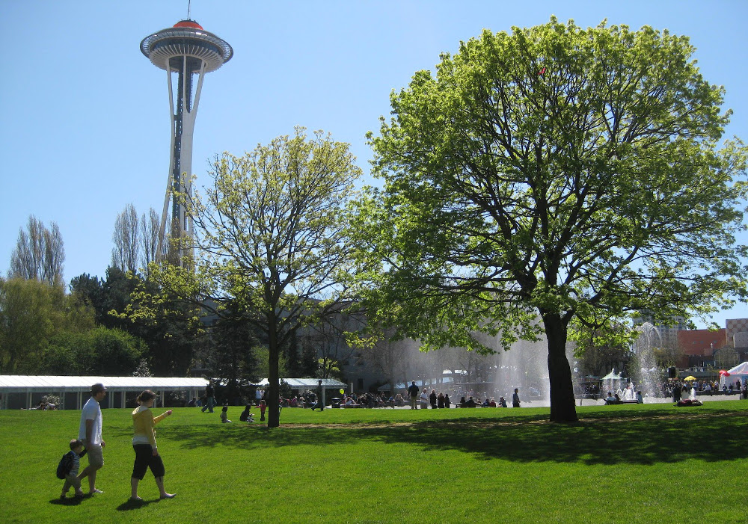
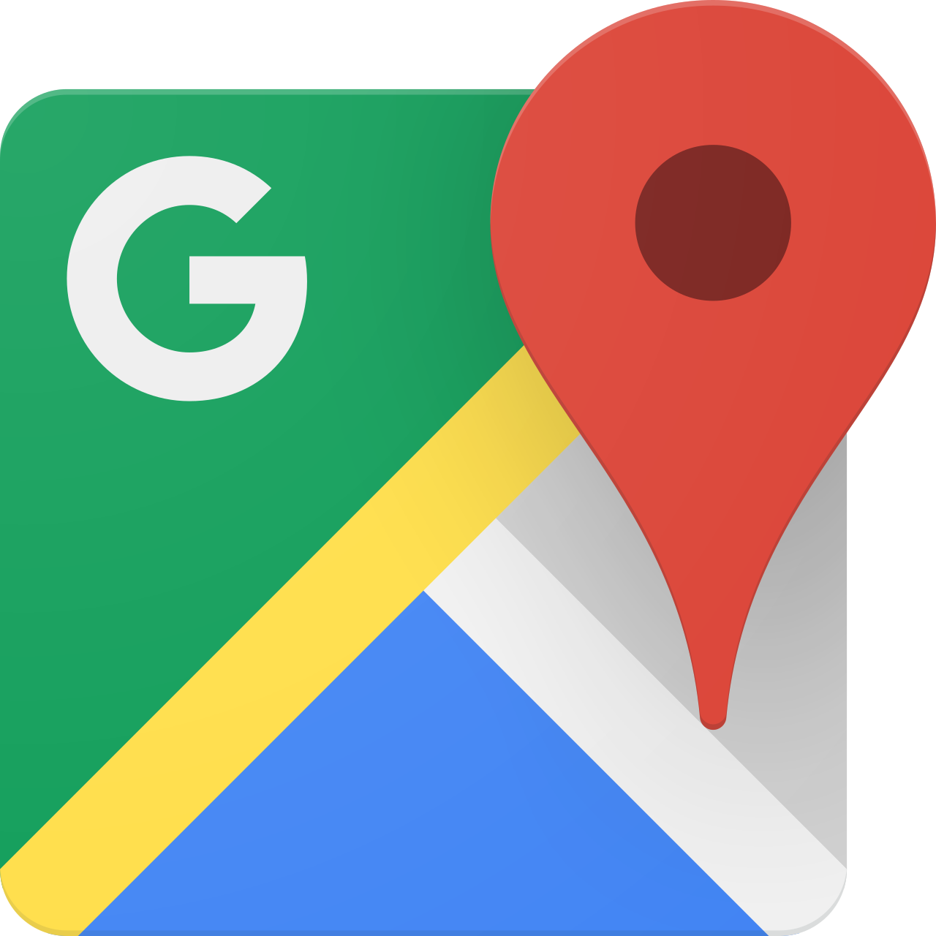
Information Story
Target user
Seattle residents, visitors, or community members who want to quickly find parks based on location and available amenities.
Notes:
Currently, Seattle has an abundance of parks that span across the city. My target user focuses primarily on residents, visitors or members in Seattle trying to find parks based on location and features.
Your best bet to finding parks currently is to rely through reviews on Google maps, as current information relies on access through reviews and photos to understand if a park is suitable for their specific needs/.
But what if the city itself could provide information about their parks to the general public?

Slide 3
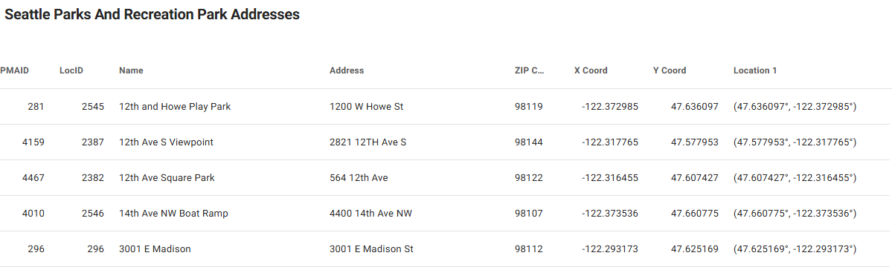
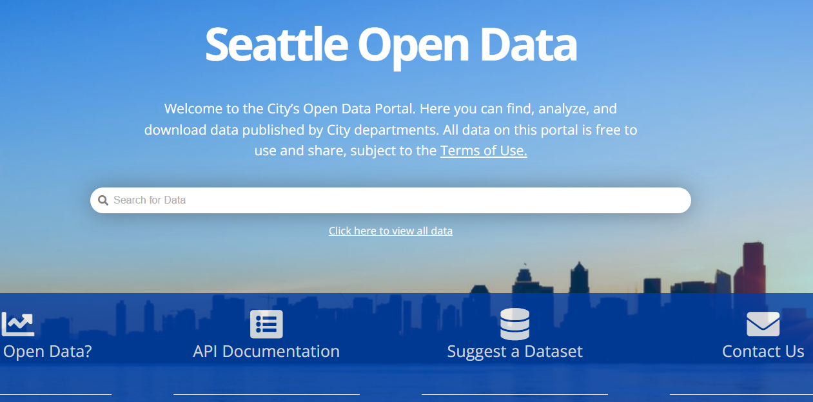
Information Story
Seattle’s park information exists, but it is not accessible for everyday users to explore.
Notes:
Seattle already provides this data through its Open Data program, including information about park amenities like basketball courts, drinking fountains, and other features.
The issue is that the data is not very usable for everyday people. It exists online, but mostly as database records, which makes it difficult for someone to quickly understand what parks are available or what amenities they offer. There also is not an easy map view that helps people explore the information visually.
This matters because people use parks for different reasons. Some may be looking for a place to play sports, some may need a gathering space, and others may just want somewhere to exercise or relax. Making this data easier to explore helps people make better decisions about which parks fit their needs.

Slide 4
Insight Focus
Goal:
Create a tool to make Seattle’s park and feature information portable and accessible
Demonstrate portability via VISUALIZATION
Gather open-source city data
Visualize data through an accessible platform
Allow the data to be interactive via map
Notes:
The goal of this project is to make information about Seattle parks and their features more portable, accessible, and useful for everyday users.
For my insight focus, I chose to create a tool that visualizes park information in a clearer way. This focus came from the idea that the main beneficiaries of this project are people who want to use parks, but may not have an easy way to explore what each offers.
I wanted to build a platform that could take Seattle’s open data, connect it into one structure, and display it through an interactive map.

Slide 5
Requirements & Scope
Requirements
Scope
Not Included
Search by park name or address
Filter for specific descriptors
Display park details, coordinates, and features via map
Seattle public parks only
Uses Seattle Open Data
Real-time conditions
Live user location
Park hours or photos
Full production deployment
Notes:
The system needs to let users search and filter Seattle parks using basic discovery information, such as park name, address, ZIP code, location, and available features.
The scope of this project is limited to Seattle public parks using existing records from the city’s Open Data program. This version does not include live user location or real-time park conditions, such as crowd levels, current hours, or temporary closures.
Instead, the focus is on proving that existing public data can be restructured into a more accessible format that users can search, filter, and explore through a map.

Slide 6
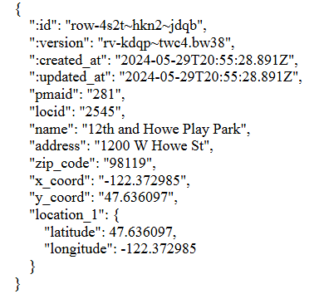
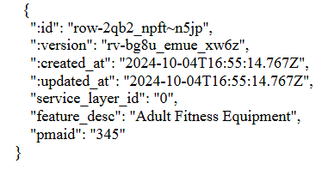
Existing Structures
Seattle Parks & Recreation Addresses JSON
Seattle Park Features by PMAID JSON
Notes:
Although they are public and available to utilize, the current structures that Seattle currently provides for park data are only accessible as CSV and JSON structures.
The first dataset is from Parks & Recreation Addresses dataset, which contains general park information, such as the park name, address, coordinates, and the property management area ID, or pmaid. The second dataset contains park feature information only and associates them solely by their PMAID.
The important part about this is that the current structure for both datasets have a shared identifier. The pmaid is what joins the two separate structures to be connected. However, in their original form, the data is still split across separate files, which makes it inaccessible for users to access and process.

Slide 7
Structure Improvements
{
"address": "1200 W Howe St",
"feature_count": 1,
"features": [
"Play Area"
],
"has_features": true,
"location_1": {
"latitude": "47.636097",
"longitude": "-122.372985"
},
"locid": "2545",
"name": "12th and Howe Play Park",
"pmaid": "281",
"x_coord": "-122.372985",
"y_coord": "47.636097",
"zip_code": "98119"
}
Seattle Park Features by PMAID
Seattle Parks & Recreation Addresses
Notes:
To fix this separation, I used the shared pmaid field to connect the park location records and feature records together. From there, I created a new compiled JSON structure.
In the improved version, each park record contains its general information, such as its name, address, ZIP code, and coordinates, but it also includes a features array. This means the amenities are no longer separated from the park record.
For example, instead of looking up a park with a specific PMAID in one file and then manually searching another file for its features, the new structure already includes those features directly inside the park object.
I used AI and Python to help parse the original datasets, match records by pmaid, and generate a new JSON file. This makes the data more portable because it can be used directly with a Flask API and integrated into Streamlit and OpenStreetMap to support filtering by features and other descriptors.
Overall, this structure better supports community needs by helping users find parks based on specific conditions, such as locating parks in a certain ZIP code that have bathrooms.

Slide 8
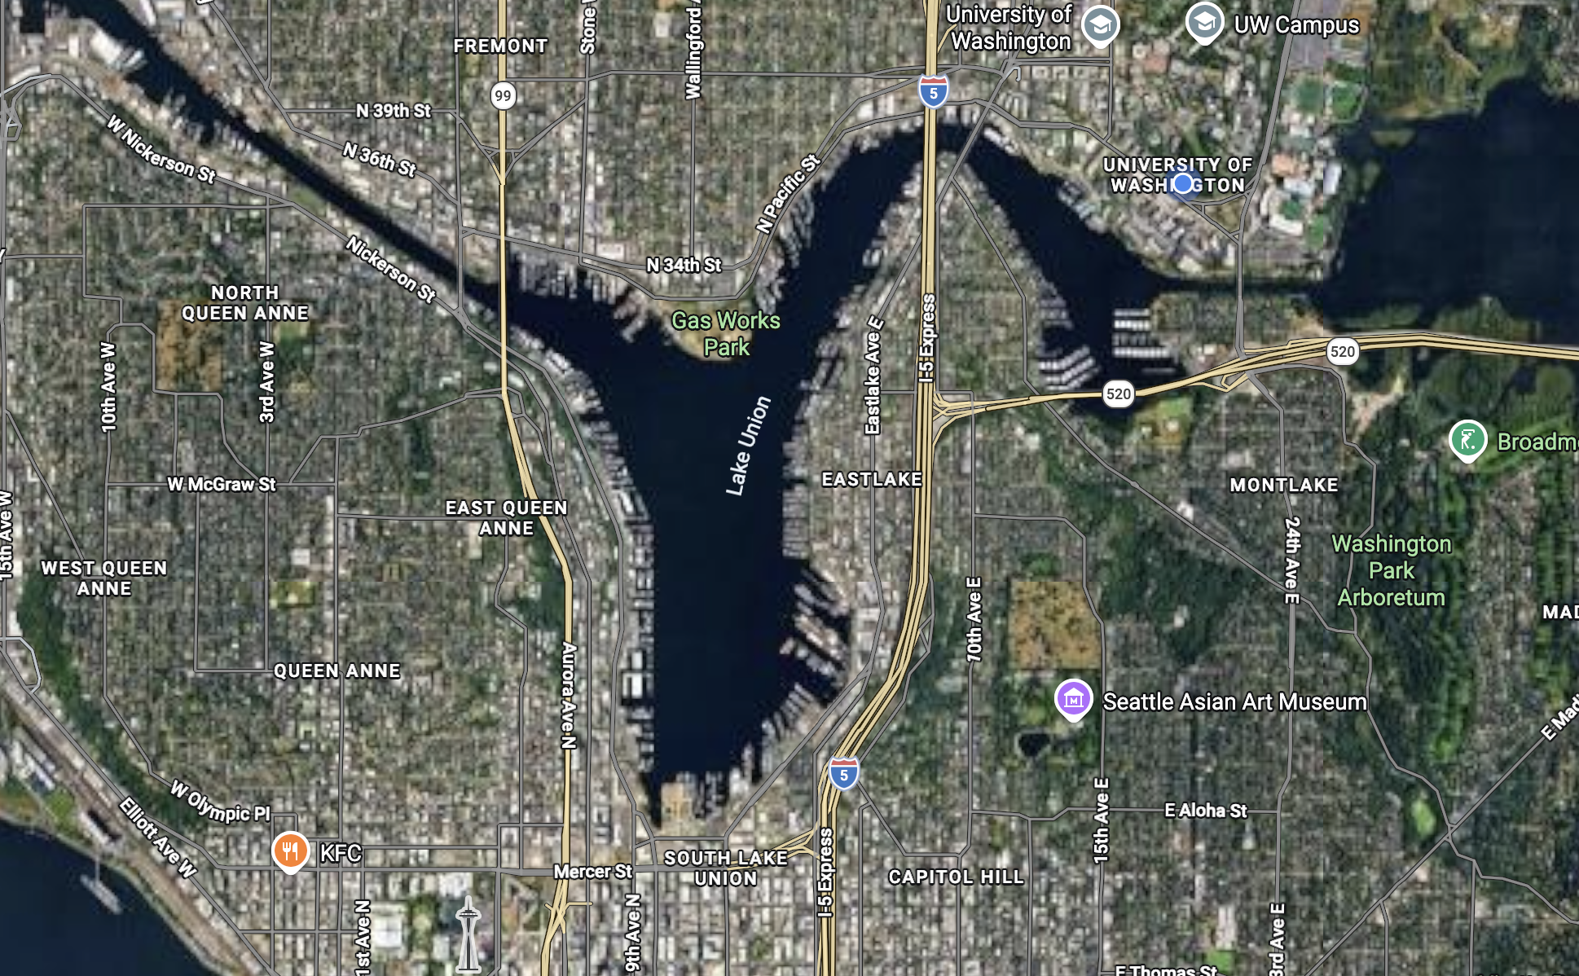
Wireframes - Low-fidelity
Filter by: None
Filter by: Basketball Court
ABC Park (ID: 3321)
123 NE 45th St.
Features: None
King Park (ID: 1231)
678 SW 91st St.
Features: Basketball Court
Notes:
For my wireframes, I focused on simplicity and accessibility. I wanted users to quickly filter parks by features, view full park details, and see results on a Seattle map. The design is intentionally simple, but it supports the main goal of the project: making the information structure easier to access, understand, and use.

Slide 9
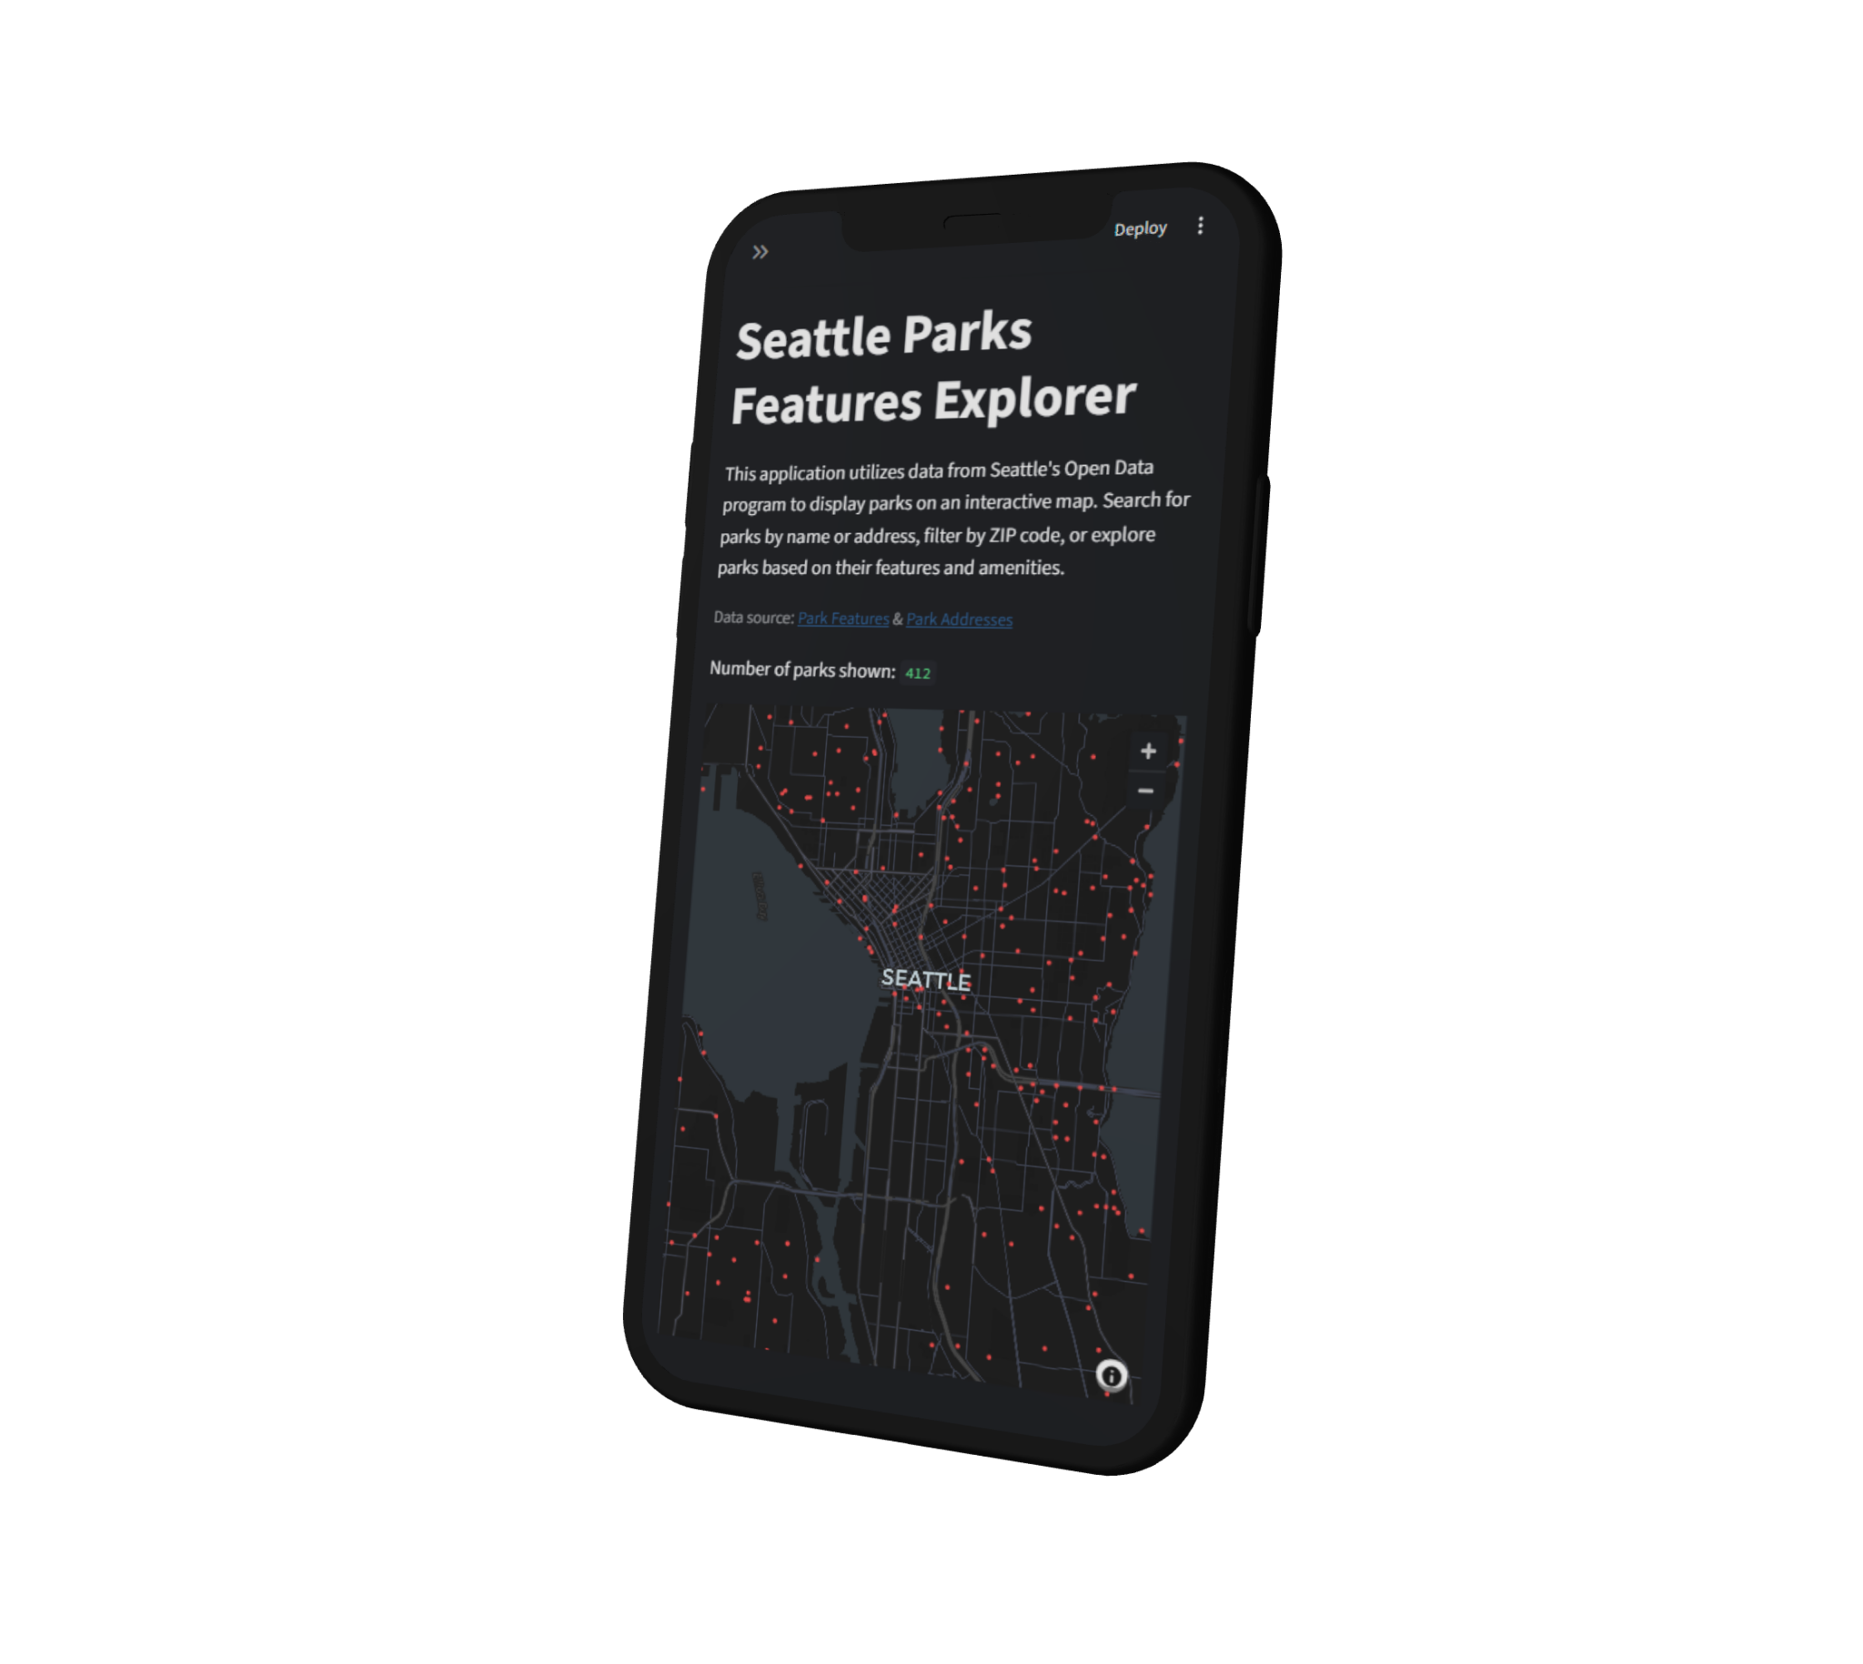
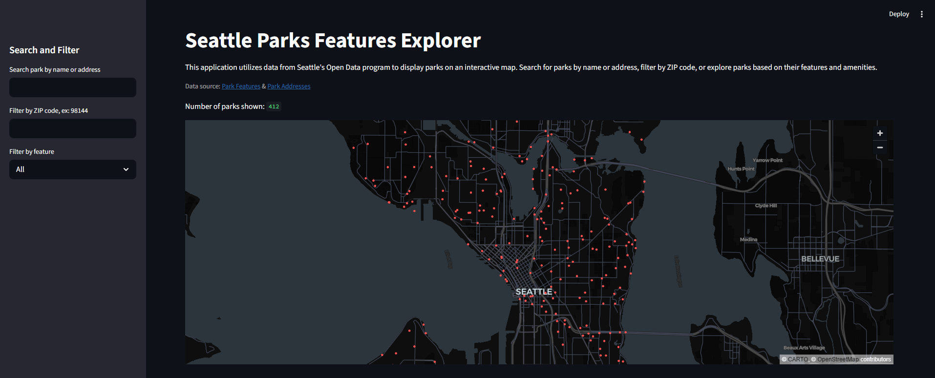
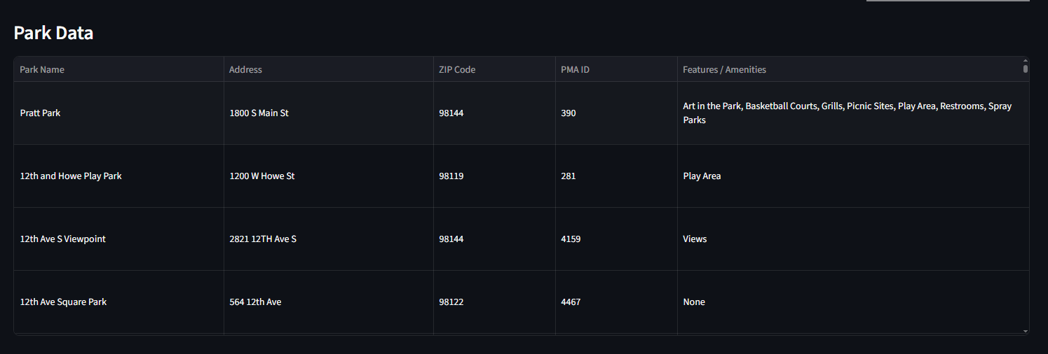
Seattle Parks Feature Explorer
Notes:
To make the improved structure accessible, I used Flask and ngrok to host API endpoints for the JSON data. I then used Streamlit to create the website interface, which displays the joined park data in an interactive and user-friendly way.
Through the site, users can access the tool from either desktop or mobile and explore parks across Seattle. They can search by name or address, filter by ZIP code, and choose specific park features to find spaces that best fit their needs.
Unfortunately, I wasn’t able to fully create a map layout that envelops the whole screen for mobile devices. Just the limitations of using streamlit, but it is usable in both mobile and desktop and accessible via link, and I felt this was an effective cost for the benefit of making it interactive thorough streamlit

Slide 10

Demo
Scan here!

Slide 11
Quality Measures
Data Quality
Security
Performance
Centralized records make missing values easier to detect
Combined JSON improves clarity and consistency
Structure supports future validation checks
Standardized records make changes easier to review
Centralized data supports integrity and consistency
API logs and endpoint testing help monitor access
Pre-integrated JSON reduces repeated data joins
API and filters can access park records more efficiently
Notes:
In terms of data quality, the improved structure makes it easier to spot missing or incomplete information because each park’s metadata, location, and features are stored together in one JSON object. This also makes it easier to run future checks for incomplete or malformed records.
For information security, the project is using public data, so confidentiality is less of a concern. However, integrity and availability still matter. By using a standardized JSON structure, changes can be tracked and reviewed more easily. API logs, error checks, and endpoint testing can also help make sure the system is reliable and working as expected.
For performance, the app does not have to repeatedly join the address and feature datasets every time someone searches or filters. Because the data is already connected through PMAID, the API and Streamlit interface can retrieve park records more efficiently.

Slide 12
FAIR Assessment
Findable Park records use pmaid as a shared identifier, connecting park location data with feature data.
Accessible The data is publicly available through Seattle Open Data and exposed through a Flask API.
Interoperable The structure uses JSON and API endpoints, allowing the data to be used by Streamlit or other applications.
Reusable The compiled structure includes park names, addresses, ZIP codes, coordinates, and features, making it useful for future park discovery tools.
Notes:
This project applies the FAIR principles through a portable API-based structure and interactive map.
For Findability, each park has a unique identifier through its pmaid, which connects the location data and feature data together.
For Accessibility, the data can be retrieved through Flask API endpoints, allowing users or applications to access park records by request.
For Interoperability, the structure uses JSON, a standard format that can be read by web apps, APIs, data tools, and other systems.
For Reusability, each park record is richly described with useful attributes, such as its name, address, ZIP code, coordinates, and available features. This makes the structure easier to reuse in other tools, maps, or applications.

Slide 13
Structure Comparison
Before
After
Park addresses and park features were separated
Users needed to interpret raw open data manually
Harder to check completeness and validity across both datasets
Each park has its address, location, and features in one object
Users can search/filter through a map
Easier to validate missing coordinates, addresses, or features
Notes:
Before the improved structure, finding park features across Seattle was a tedious process. Park location data and feature data were stored separately, which made the information harder to access and use for everyday people who just want to find parks that match their needs.
With the new Park Feature Explorer, that information is brought together in a more accessible way. Users can explore parks through the map, search by name or address, filter by ZIP code, and choose specific amenities or features they are looking for.
By joining everything into one centralized JSON record, the structure also makes the data easier to validate and more accurate, since each park now contains its metadata, location, and features in one place, provided by data from the City of Seattle.

Slide 14
Thank you!
Questions?

